Slide 1
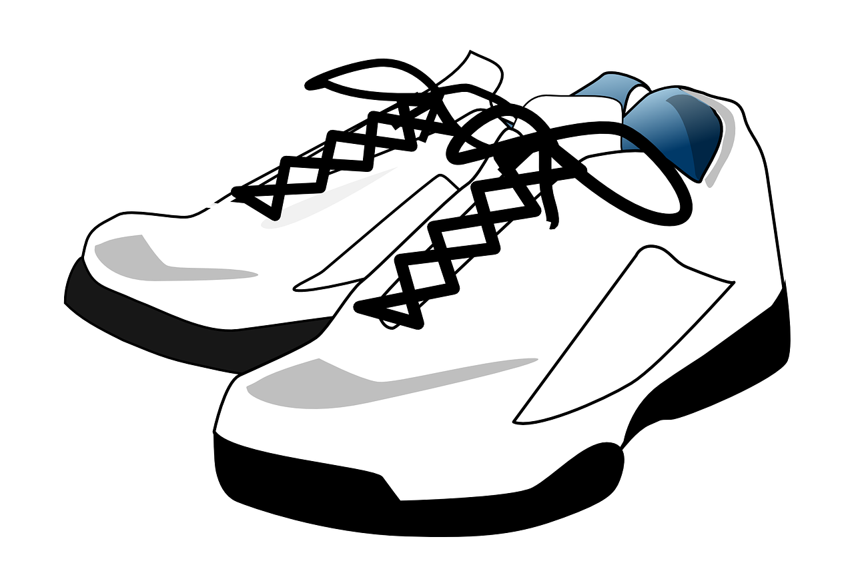
Fit Footwear Co.
Created By:
Rodolphe Eugene
Esperandieu Alfred
Acka Arman
RE

Slide 2
Executive summary of business
Fit Footwear Co. is a well known shoe company and have been in business for over 3 decades, and the company’s goal is to satisfy customers with our sporting shoe-wear products. Over the years, there have been a few drawbacks preventing this goal from being accomplished, but now it is definitely possible. On the way to improve the company’s figure, we have made endorsement deals with some of the most well-known athletes of our generation. With the help of their starpower, the business can reach new heights. But first, a few issues needs to be solved with the company’s information system.
RE

Slide 3

Famous Athletes Endorsed
· Lebron James- American Professional Basketball player
· Usain Bolt - Jamaican Track and Field Superstar
· Lionel Messi- An Argentinian Professional Soccer player
These individuals listed above are some of the most prominent figures representing our company, and our goal is to continue to make high-quality sport wear for today’s generation. With that being said, the company is working on making some improvements to the way customer and order data is being processed.
RE

Slide 4

Problems
Problem 1:
Conflicts with data redundancy in updating the spreadsheet containing information about invoices, customer information, and orders
Problem 2:
The company is having issues Identifying sell records due to unorganized information on customers and orders
RE

Slide 5

Solutions
Problem 1 Solution:
The unique constraints can be used on columns on an entity within the database, which will ensure that the values in specified columns are unique.
A primary key can be used to prevent data duplication because primary keys are used to identify a unique record in a table.
Problem 2 Solution:
To create multiple tables to represent each piece of information being processed by the company.
Applying the normalization process to the entities inside of the database.
RE

Slide 6
Constraints
· VENDORS must purchase at least 40 products of any PRODUCT
· INVOICES , ORDER, and EMPLOYEE table should not contain any NULL values, and each must be assigned a unique key.
· SALES_REPORT should not contain any NULL values
· STORES must carry at least 1 BRAND.
E.A

Slide 7
Defined Objectives
Our objective is to create a database that will help Fit Footwear Co. to have much higher control over customer information and orders. More importantly, to improve the company’s data accuracy and ease of data access by avoiding data redundancy.
E.A

Slide 8
Key Business rules (summarize important ones, do not list all of them)
Business Rules:
· Each product may have its inventory record. · Many products can belong to the same brand, but each product is associated with only one brand. · A vendor may supply multiple inventories. · A customer can place multiple orders, but each order belongs to only one customer. · A customer may own multiple brands. · A customer can write multiple reviews, but each review is written by only one customer. · Each customer has only one CRM record. · Each order has a single invoice. · A store can have multiple employees, but each employee works at one store. · An employee can generate multiple sales reports, but each report is generated by only one employee. · A sales report can be generated for one store, but each store can have multiple sales reports.
E.A

Slide 9
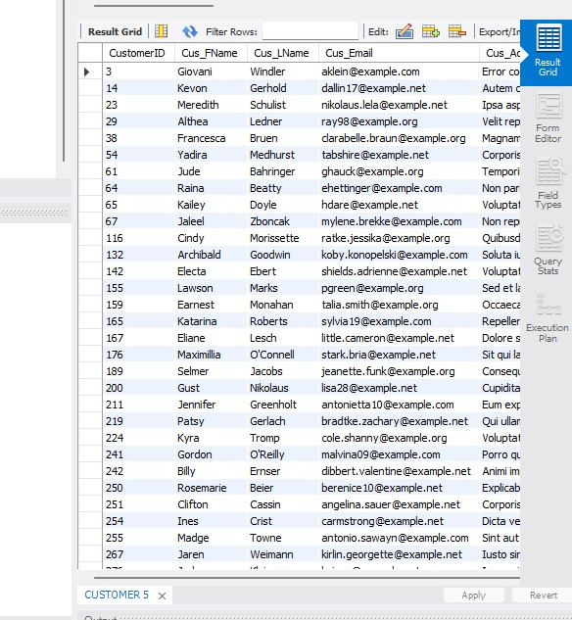
Customer Table and Attributes
Table that show values insert into brand

Slide 10
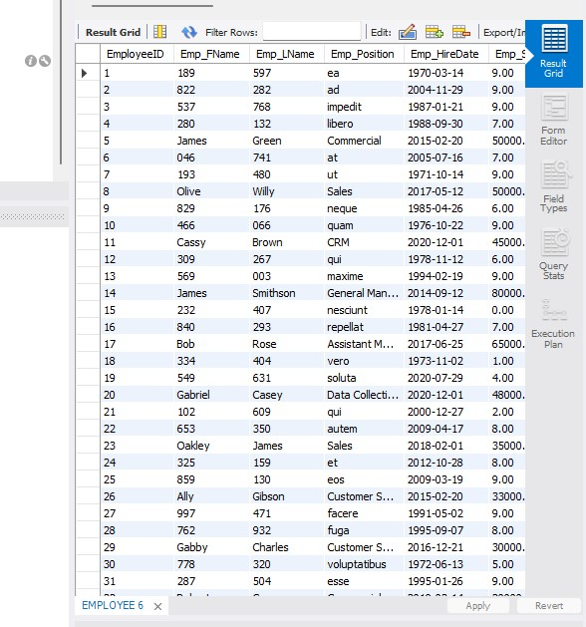
EMPLOYEE Table and Attributes

Slide 11
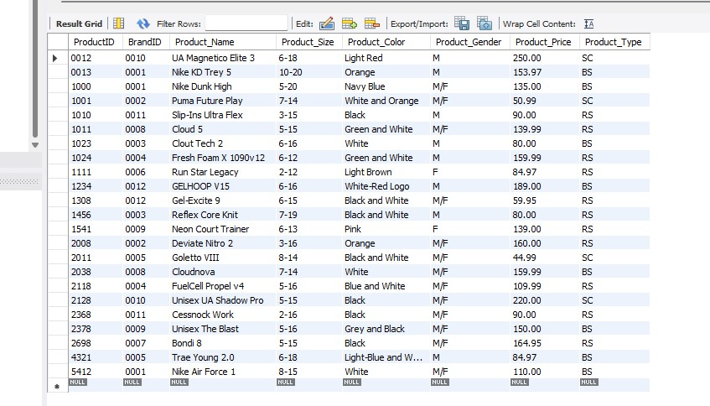
PRODUCT Table and Attributes

Slide 12
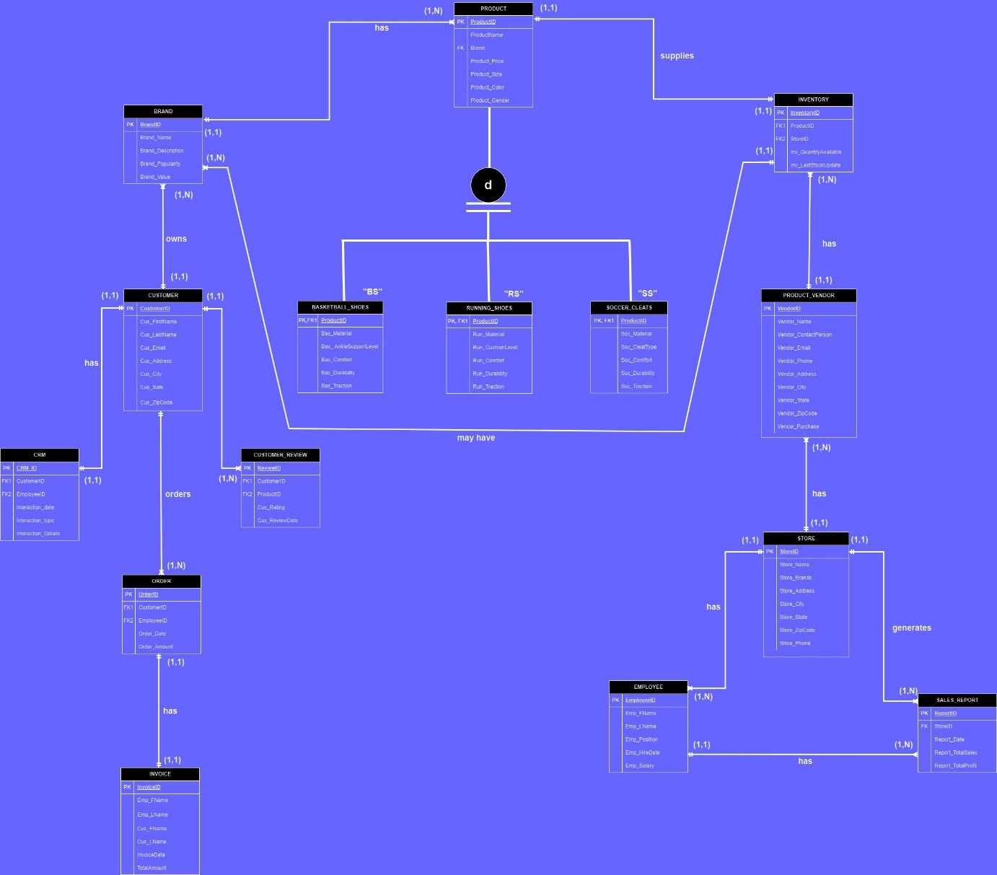
EERD
Link to DrawIO:
https://app.diagrams.net/#G1yOpGVS9W4a4SirTtWwLQj1wts_hQi69A

Slide 13
Biggest challenge
Coming up with the business rules and construct the EERD model.
When we started working on the table, the only challenge that we came across was having all of the tables in the right order since most of them has foreign keys and must obtain information for another table.
Time management and communication: we live in different cities and have different working schedules for our jobs
Solution: We created sharable files on google docs, group video calls, and set a clear objective goal timeline to complete the project by.

Slide 14
Summary of database solution
The two problems highlighted were fairly simple to justify. First, the conflicts with data redundancy in updating the spreadsheet containing values information on customers and orders were handled using unique constraints on a few tables containing customer information. Another key to resolving this problem was to use the primary key to force unique identification values for customers, orders, invoices, and Employees, to say the least. In case, the individual updating the spreadsheet forgets to add a unique key, most of the tables in the database do not allow NULL values. It will alert the end user that there is an empty slot. Also, the normalization process is also being used to reduce data redundancy.
Secondly, the problem with identifying sell records due to unorganized information on customers and orders took a bit more time to resolve. The first approach was to create multiple tables in the database to break down the information being processed by the company. There is a table for Orders, Customers, and Invoices. A unique value must be entered for each row in the table. As a result, this process makes it easier for end-users to access data since every entity is on its own and each entity contains relatable information. More importantly, the company can now access data effortlessly and with more accuracy. In other words, greater control over data will be present from now on.
Overall, the entire database is aiming to make the component more efficient with Sales, Invoices, Customer information, and how fast the company can retrieve the data needed. This database will fulfill that requirement due to its adaptation of a handful of SQL commands that heavily supports data integrity.

Slide 15
What you learned
From doing this project, we gain a better understanding of a database background and constructing an EERD model. Also, we gain more knowledge in database design, business logic, normalization process, MySQL, database management, problem solving and handling errors.
E.A

